Slide 1
Routing and Deadlock
By Team Deadlock

Slide 2
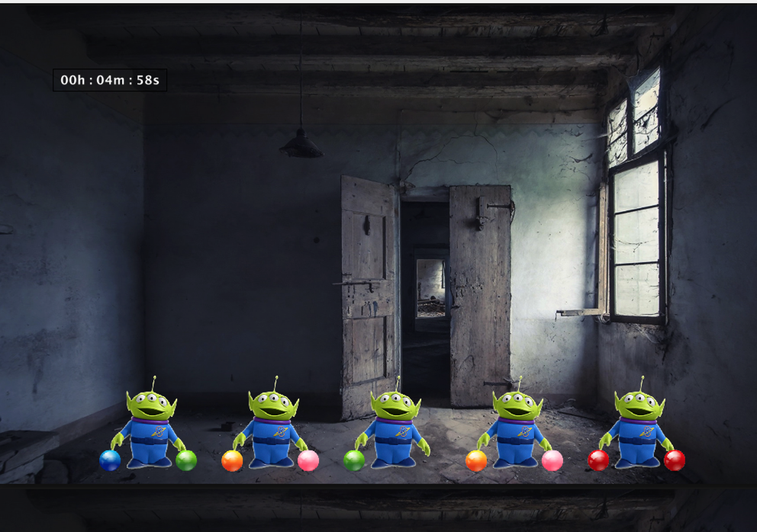
Introduction
Game Objective - Work together to solve a sharing of resource problem
Game Summary
Players must have the same color ball in both hands
Multiplayer (at least 5 users must play)
Time limit to solve the puzzle
Chat capabilities to interact with other users
Dockerize Java backend with Greenfoot UI

Slide 3
Patterns
Factory Method (Server & Client sides)
State (Server side)
Strategy (Server side)

Slide 4
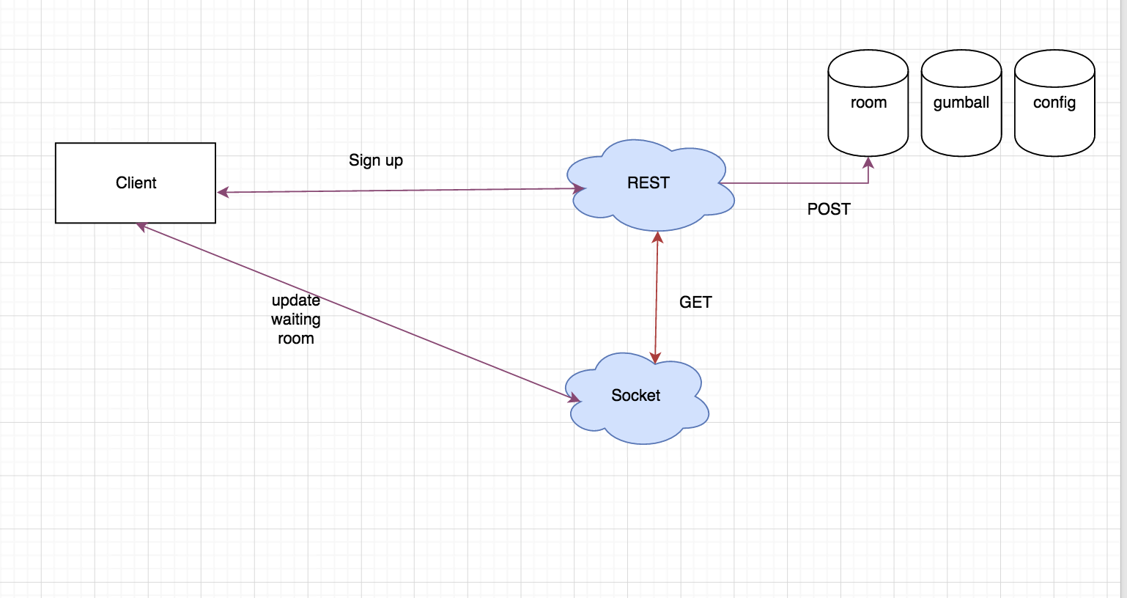
Flow Diagrams – Sign Up

Slide 5
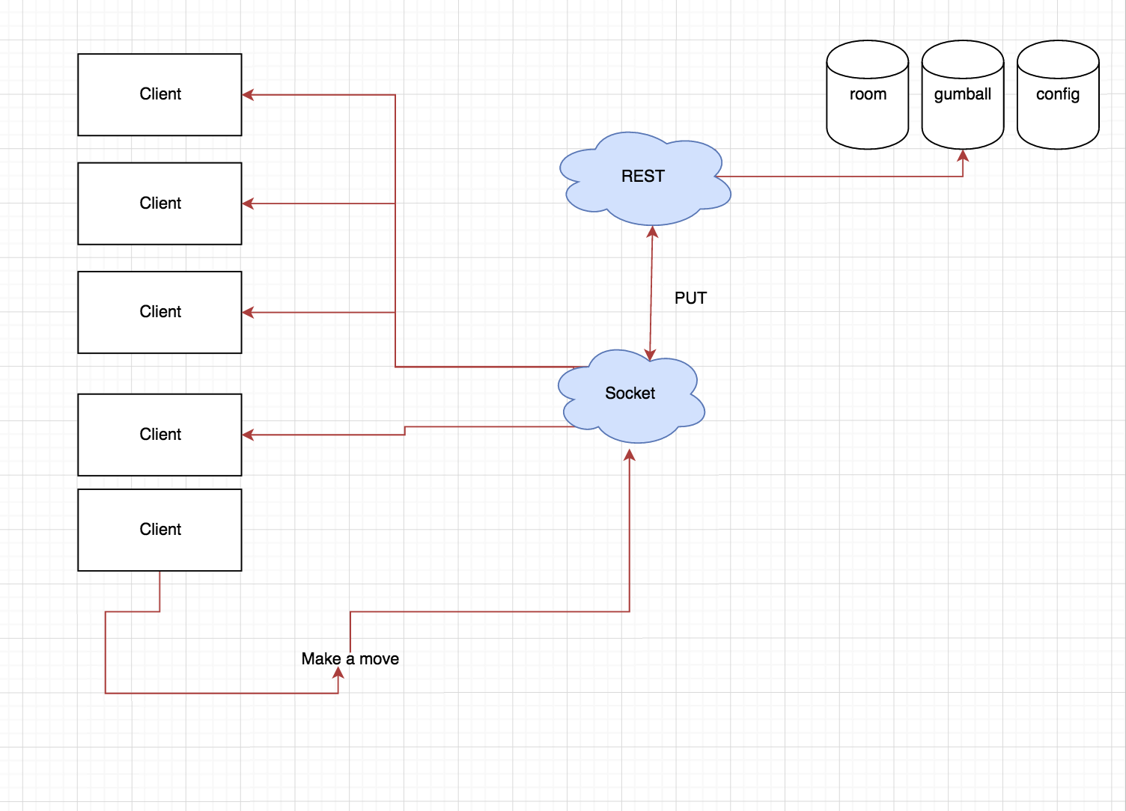
Flow Diagrams – Making A Move

Slide 6
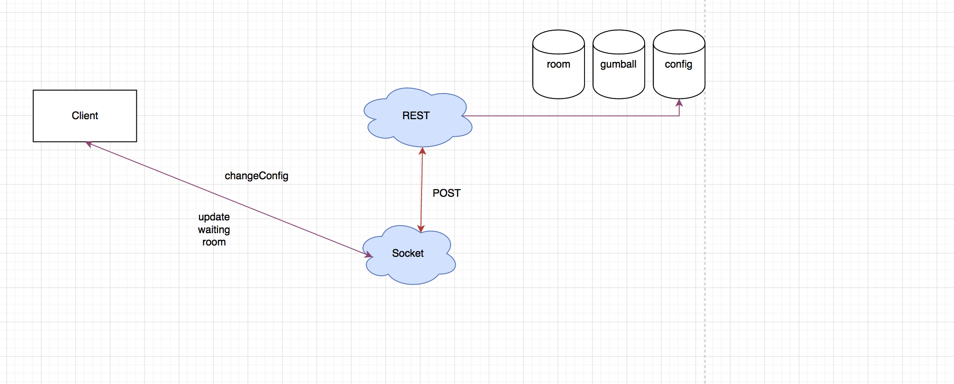
Flow Diagrams – Changing A Config

Slide 7
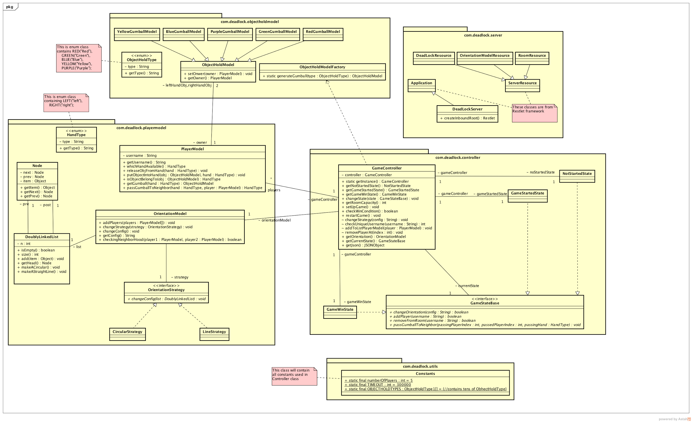
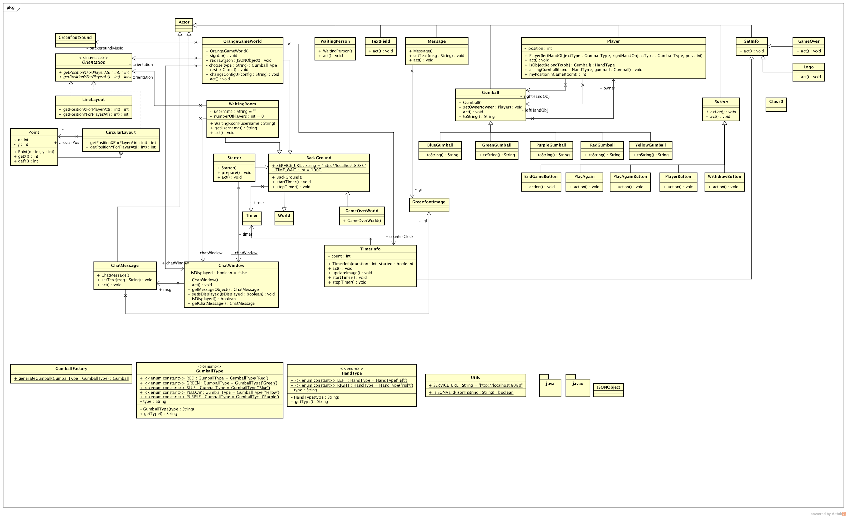
Class Diagrams

